Slide 1
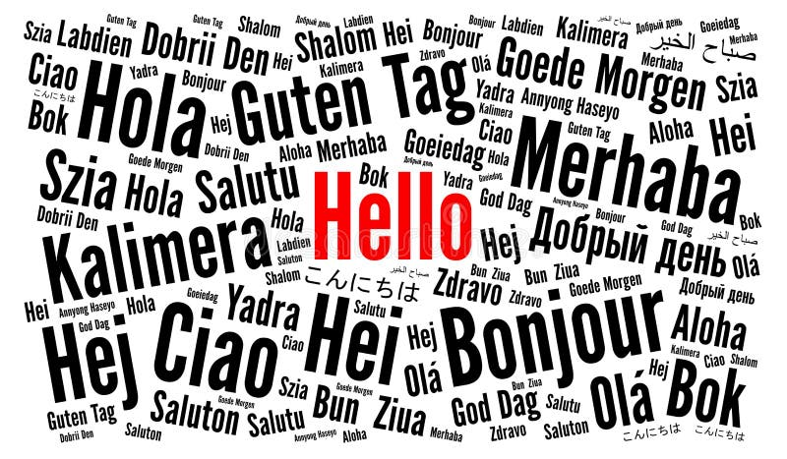
Translate Hub
Multi Language Translator made using JavaScript and Restful API
Pranay Shelar
BCA Sem 6
A7100821034

Slide 2
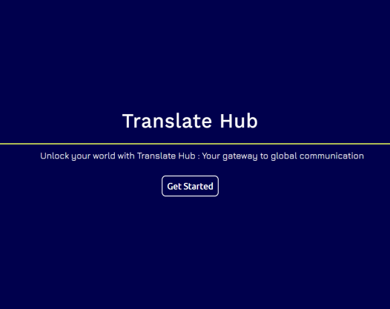
InTroduction
A cutting-edge language translation website
Utilizes HTML, CSS, JavaScript, and Bootstrap
Employs APIs for accurate and efficient translations
Features a user-friendly interface and responsive design

Slide 3


Objective
Provide seamless and accurate language translations
Enhance global communication and accessibility
Support diverse languages and dialects
Offer additional features such as text-to-speech and copy-to-clipboard
Ensure a high-quality user experience through continuous improvement

Slide 4
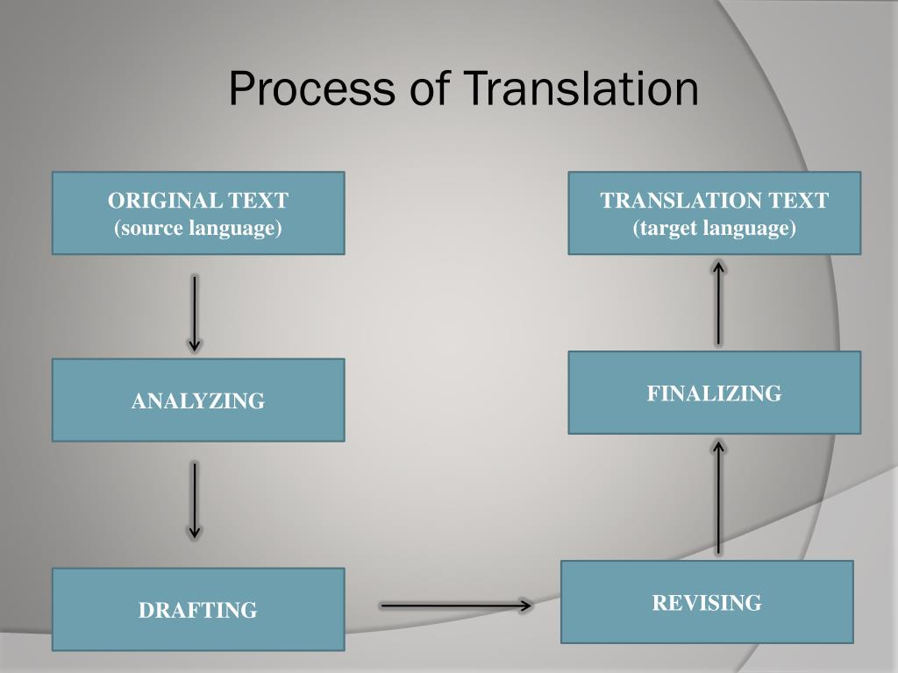
Methodology
Front-end Development:
HTML, CSS, and Bootstrap for responsive design
JavaScript for dynamic content and user interactions
Back-end Integration:
APIs for real-time translation (e.g., MyMemory API)
Firebase for managing contact form submissions and queries
Features:
Text input for source language
Language selection dropdowns
Translated text display
Text-to-speech functionality
Copy-to-clipboard feature

Slide 5
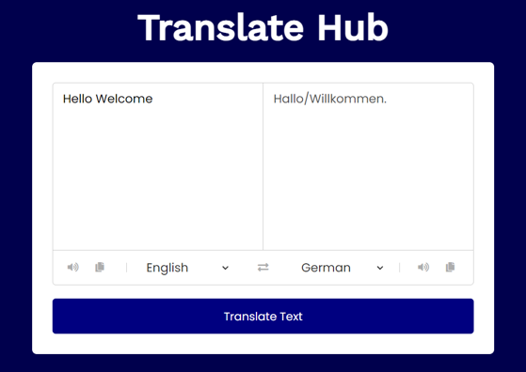
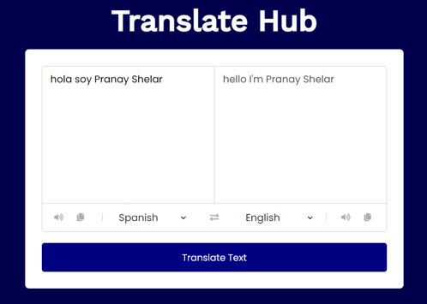
rESUlT
Multi Language Support
User-friendly interface with real-time translation capabilities
English to German
Spanish to English

Slide 6
THANK YOU

